Slide 1
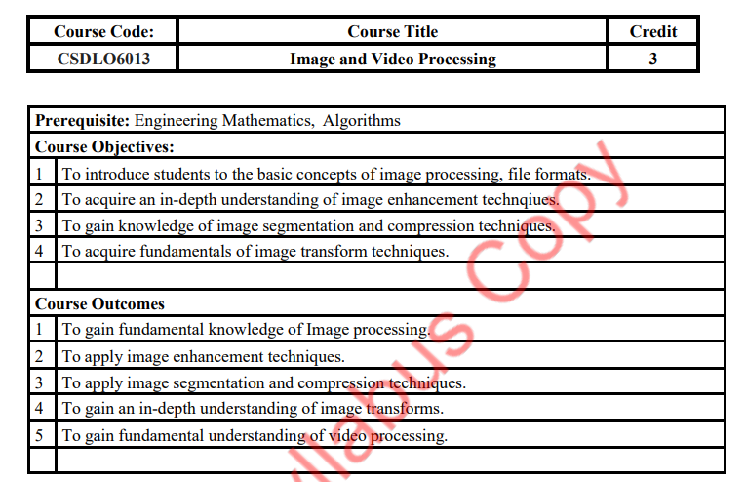

Slide 2
Module No. | Name of Module | Hours | Marks
1 | Digital Image Fundamentals | 4 | 12
2 | Image Enhancement in Spatial domain | 8 | 25
3 | Image Segmentation | 6 | 18
4 | Image Transforms | 9 | 28
5 | Image Compression | 8 | 25
6 | Digital Video Processing | 4 | 12
Total |  | 39 | 120

Slide 3
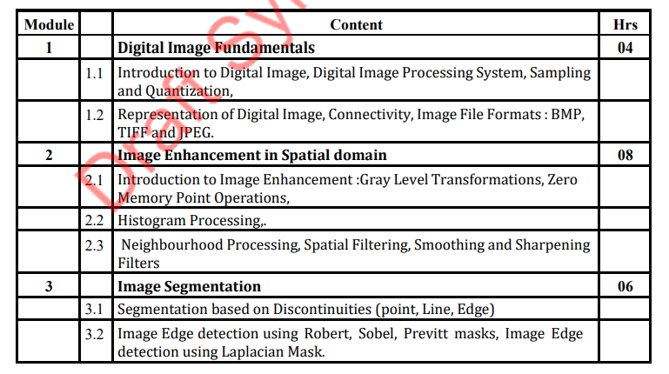

Slide 4
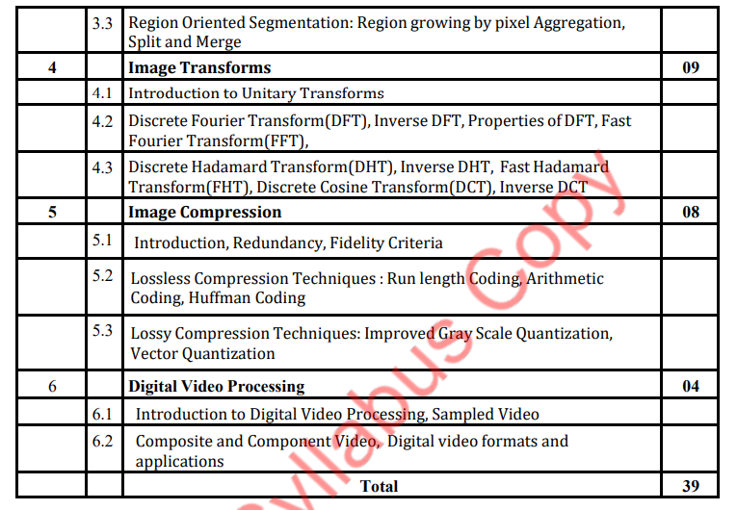

Slide 5
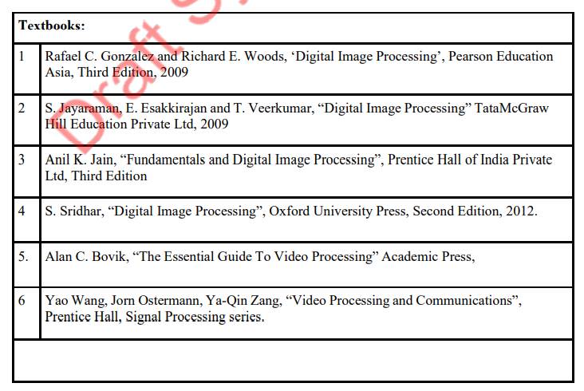

Slide 6
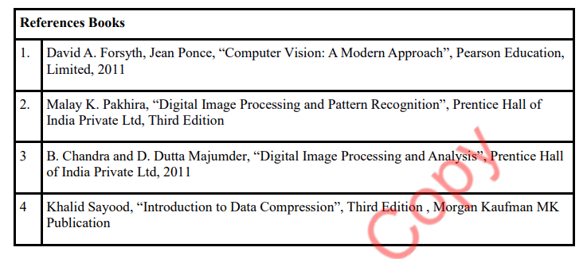

Slide 7
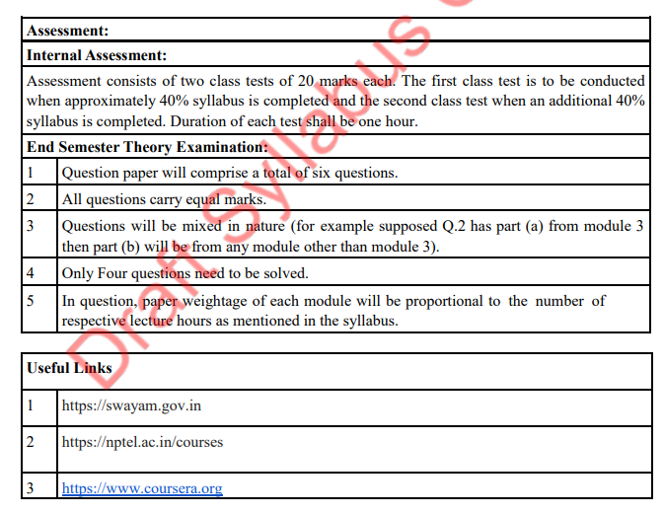

Slide 8
Module 1
Digital Image Fundamentals

Slide 9
References
Gonzales and Woods, “Digital Image Processing”, Pearson Education, India, Third Edition
Digital image processing – Ramesh Jayraman
Digital Image processing - Sreedhar

Slide 10
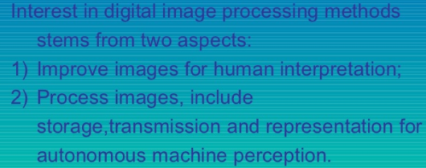

Slide 11
Fundamental Steps in Digital Image Processing

Slide 12
Note that acquisition could be as simple as being given an image that is already in digital form. Generally, the image acquisition stage involves preprocessing, such as scaling.
Image enhancement is the process of manipulating an image so that the result is more suitable than the original for a specific application.
Image restoration is an area that also deals with improving the appearance of an image. However, unlike enhancement, which is subjective, image restoration is objective, in the sense that restoration techniques tend to be based on mathematical or probabilistic models of image degradation. Enhancement, on the other hand, is based on human subjective preferences regarding what constitutes a “good” enhancement result.
Color image processing is an area that has been gaining in importance because of the significant increase in the use of digital images over the Internet.
Wavelets are the foundation for representing images in various degrees of resolution.

Slide 13
Compression, as the name implies, deals with techniques for reducing the storage required to save an image, or the bandwidth required to transmit it.
Image compression is familiar (perhaps inadvertently) to most users of computers in the form of image file extensions, such as the jpg file extension used in the JPEG (Joint Photographic Experts Group) image compression standard.
Morphological processing deals with tools for extracting image components that are useful in the representation and description of shape.
Segmentation procedures partition an image into its constituent parts or objects.
Representation and description almost always follow the output of a segmentation stage, which usually is raw pixel data, constituting either the boundary of a region (i.e., the set of pixels separating one image region from another) or all the points in the region itself.
Recognition is the process that assigns a label (e.g., “vehicle”) to an object based on its descriptors

Slide 14
Components of an Image Processing System

Slide 15
Image Sensors: Image sensors senses the intensity, amplitude, co-ordinates and other features of the images and passes the result to the image processing hardware. It includes the problem domain.
Image Processing Hardware: Image processing hardware is the dedicated hardware that is used to process the instructions obtained from the image sensors. It passes the result to general purpose computer.
Computer: Computer used in the image processing system is the general purpose computer that is used by us in our daily life.
Image Processing Software: Image processing software is the software that includes all the mechanisms and algorithms that are used in image processing system.
Mass Storage: Mass storage stores the pixels of the images during the processing.
Hard Copy Device: Once the image is processed then it is stored in the hard copy device. It can be a pen drive or any external ROM device.
Image Display: It includes the monitor or display screen that displays the processed images.
Network: Network is the connection of all the above elements of the image processing system.

Slide 16
Classification of Digital Images
Raster Image or Bitmap Image
Generally defined as rectangular array of regularly sampled values known as pixels
Mapped to the grid & Not easily scalable
Resolution dependent as it contains fixed number of pixels
Scanned graphics , Web Graphics
Vector Image :-
Vector Image made up of lines and curves that are mathematically defined in a computer
Easily scalable
Suitable for typography, line art and illustrations

Slide 17
IMAGE TYPES:-
Black and White or Binary Images
Grayscale images
Color Images
Multispectral Images

Slide 18
Black and White or Binary Images :-
Binary images take only two values either 0 or 1
Grayscale images
Grayscale image contains only brightness information
Each pixel value corresponds to amount of quantity light
Brightness graduation can be differentiated in a grayscale image.
Each pixel is represented by a byte or word

Slide 19
Color Images
It has three values per pixel and they measure intensity and chrominance of light
Each pixel is vector of color component
Actual infornmation stored in digital data is brightness information in each spectral band
Models:- RGB, HIS, CMYK
Multispectral image
Multispectral images are different images takesn in different bands of visible or infrared regeions of the electromagnetic spectrum

Slide 20
Digital Image Definition
An image can be defined as a two-dimensional function f(x,y)
x,y: Spatial coordinates
f: the amplitude of any pair of coordinate x,y, which is called the intensity or gray level of the image at that point.
x,y and f, are all finite and discrete quantities.
• Image Processing image in → image out
• Image Analysis image in → measurements out
• Image Understanding image in → high-level description out

Slide 21
Purpose of Image processing
1. Visualization - Observe the objects that are not visible.
2. Image sharpening and restoration - To create a better image.
3. Image retrieval - Seek for the image of interest.
4. Measurement of pattern – Measures various objects in an image.
5. Image Recognition – Distinguish the objects in an image.

Slide 22
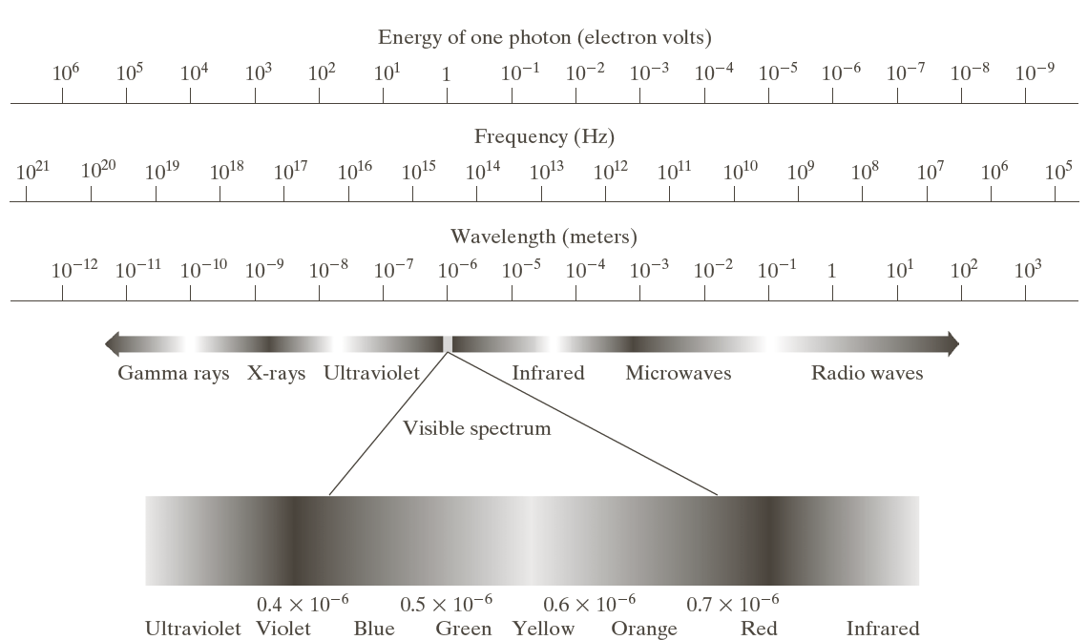
Light and the Electromagnetic Spectrum

Slide 23
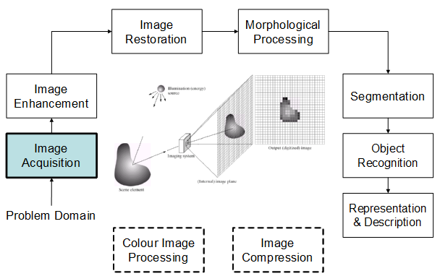
Step 1: Image Acquisition
The image is captured by a sensor (eg. Camera), and digitized.

Slide 24
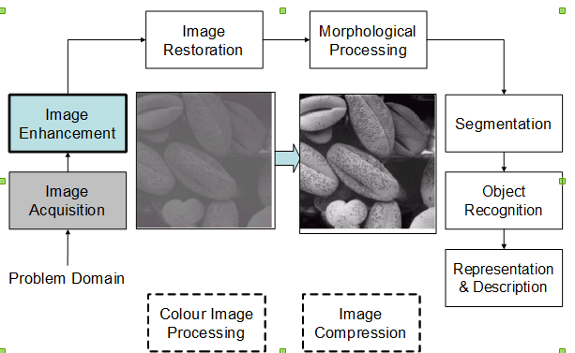
Step 2: Image Enhancement
The process of manipulating an image so that the result is more suitable than the original for specific applications.
- bring out details that are hidden.
-highlight certain features of interest

Slide 25
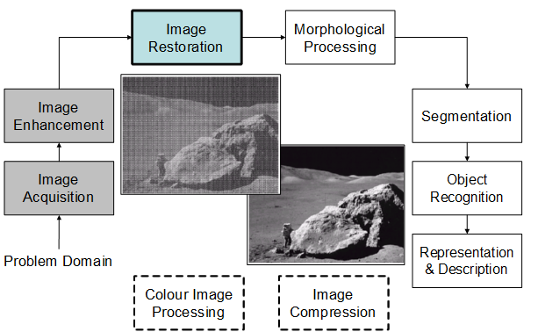
Step 3: Image Restoration
- Improving the appearance of an image
- Tend to be mathematical or probabilistic models of image degradation.

Slide 26
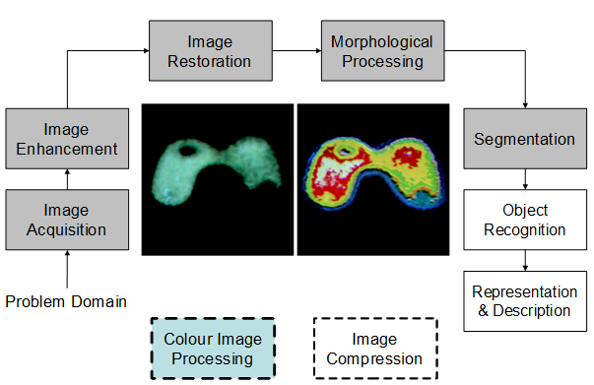
Step 4: Colour Image Processing
Use the colour of the image to extract features of interest in an image

Slide 27
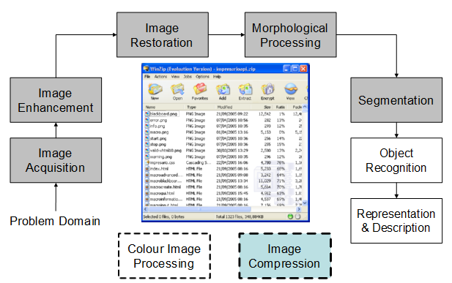
Step 5: Wavelets
Are the foundation of representing images in various degrees of resolution. It is used for image data compression.
Step 6: Compression
Techniques for reducing the storage required to save an image or the bandwidth required to transmit it.

Slide 28
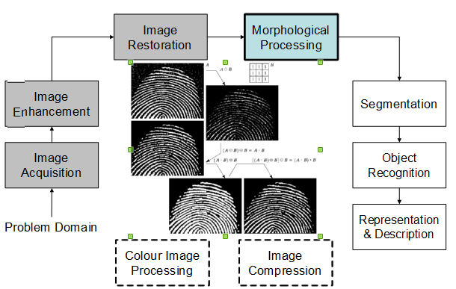
Step 7: Morphological Processing
Tools for extracting image components that are useful in the representation and description of shape.
- from processes that output images, to processes that output image attributes.

Slide 29
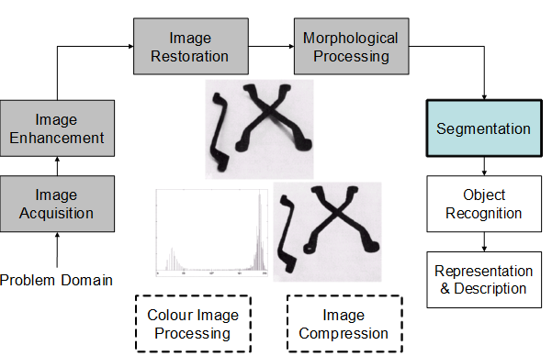
Step 8: Image Segmentation
Segmentation procedures partition an image into its constituent parts or objects.
Important Tip: The more accurate the segmentation, the more likely recognition is to succeed.

Slide 30
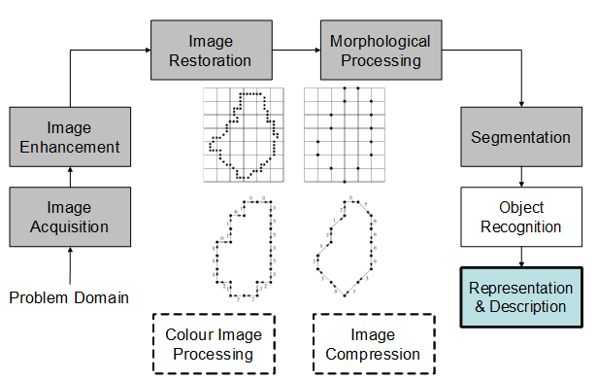
Step 9: Representation and Description
Representation: Make a decision whether the data should be represented as a boundary or as a complete region. It is almost always follows the output of a segmentation stage.
Boundary Representation: Focus on external shape characteristics, such as corners and inflections
Region Representation: Focus on internal properties, such as texture or skeleton shape

Slide 31
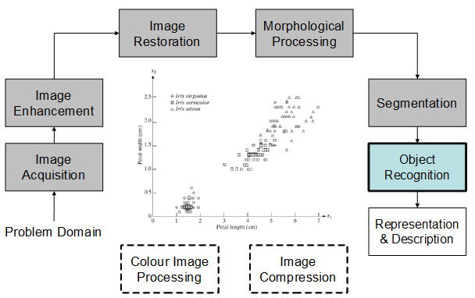
Description: or feature selection, deals with extracting attributes that result in some information of interest.
Step 9: Recognition and Interpretation
Recognition: the process that assigns label to an object based on the information provided by its description.

Slide 32
Step 10: Knowledge Base
Knowledge about a problem domain is coded into an image processing system in the form of a knowledge database.
--to guiding the operation of each processing module.
- controls the inteacton between modules.

Slide 33
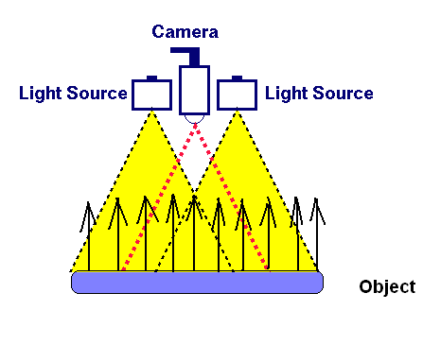
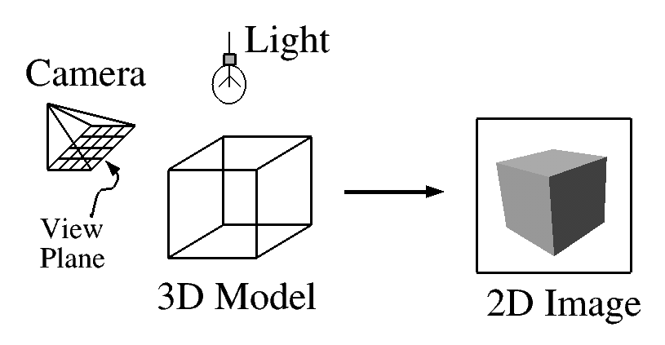
Image Sensing and Acquisition
Depending on the nature of the source, illumination energy is reflected from, or transmitted through, objects.
Use of reflected or transmitted energy:
Application: Electron microscopy and some applications of Gamma imaging.

Slide 34
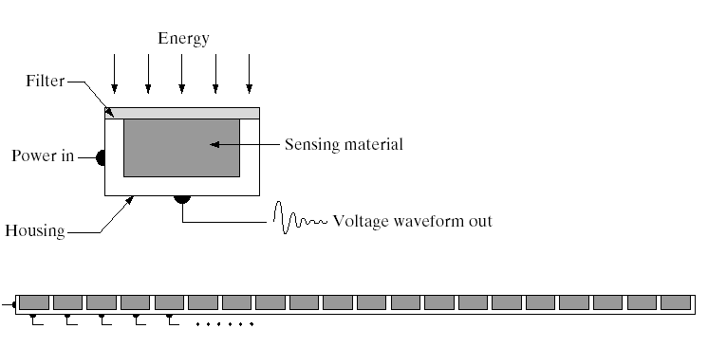
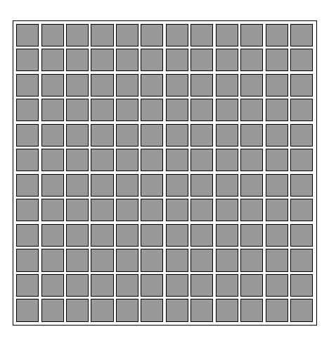
Principal Sensor Arrangements
(a) Single imaging sensor
(c) Array sensor.
(b) Line sensor.

Slide 35
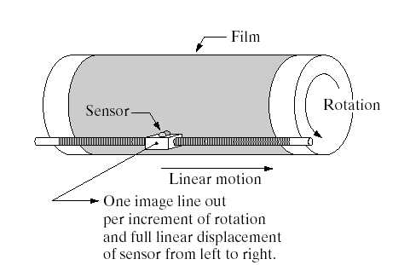
Single sensor
Combining a single sensor with
motion to generate a 2-D image.

Slide 36
Line scan camera
The imaging strip gives one line of an
image at a time, and the motion of the
strip completes the other dimension of
a two-dimensional image.
-Airborne imaging applications

Slide 37
USES
Basis for medical and industrial computerized axial tomography (CAT)
---other modalities based on CAT is MRI(magnetic resonance imaging) and
---PET (position emission tomography)

Slide 38
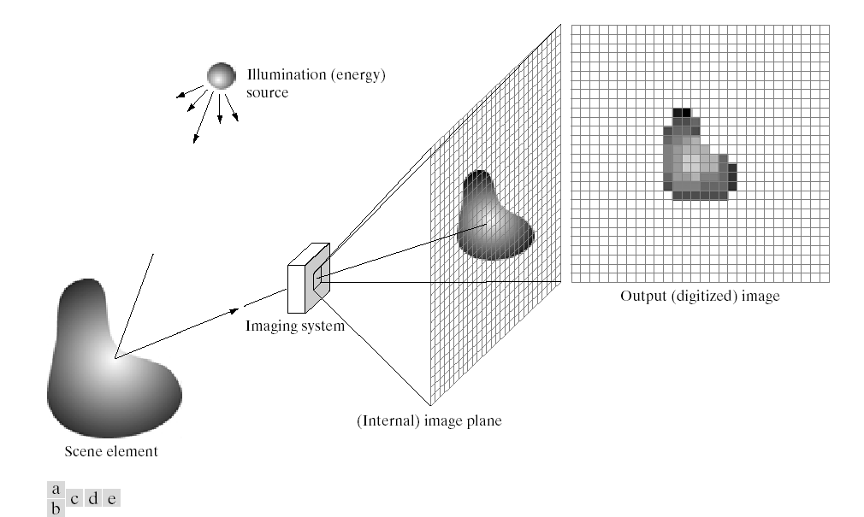
Sensor Arrays
A typical sensor for these cameras is a CCD/CMOS array
Illumination source.
(b) An element of a scene.
(c) Imaging system.
(d) Projection of the scene onto the image plane.
(e) Digitized image.

Slide 39
A Simple Image Formation Model
The function f(x, y) may be characterized by two components:
illumination i(x, y) and reflectance r(x, y)
f(x, y) = i(x, y)* r(x, y)
where
0< i(x, y)< ∞
and
0< r(x, y)< 1.
(theoretical bounds)‏

Slide 40
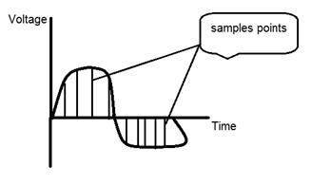
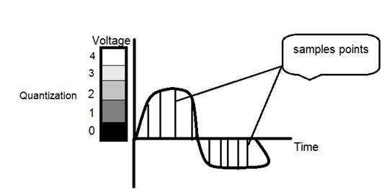
Image Sampling and Quantization
A digital sensor can only measure a limited number of samples at a discrete set of energy levels
Quantisation is the process of converting a continuous analog signal into a digital representation of this signal

Slide 41
Image Sampling and Quantization
we see that there are numerous ways to acquire images, but our objective in all is the same: to generate digital images from sensed data.
The output of most sensors is a continuous voltage waveform whose amplitude and spatial behavior are related to the physical phenomenon being sensed.
To create a digital image, we need to convert the continuous sensed data into digital form. This involves two processes: sampling and quantization.
Digitizing the co-ordinate values is called sampling
Digitizing the amplitude values is called quantization

Slide 42
Image Sampling and quantization

Slide 43
Image Sampling and quantization

Slide 44
Representing digital images
-Continuous image function = f(s; t)
Convert f(s; t) into a digital image.
-Sample the continuous image into a 2D array f(r; c) with M rows and N columns, using integer values for discrete coordinates r and c
r = 0, 1, 2,......,M - 1 and c = 0, 1, 2,....,N- 1
Matrix of real numbers, with M rows and N columns

Slide 45
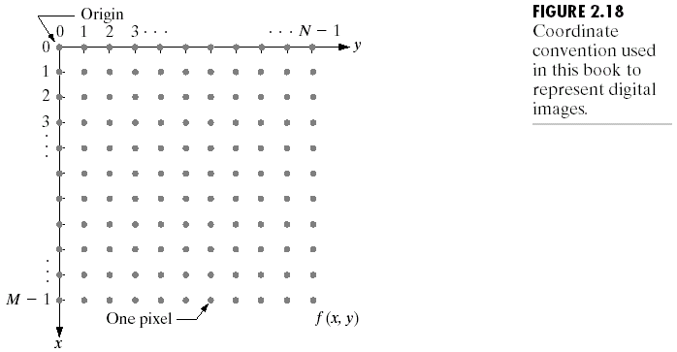
Representing digital images

Slide 46
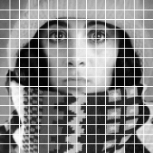
Columns
Rows
Digitization of a continuous image. The pixel at coordinates [m=10, n=3]
Value = a(x, y, z, λ, t)

Slide 47
Common values of digital image parameters
Parameter Symbol Typical values
Rows M 256,512,525,625,1024,1080
Columns N 256,512,768,1024,1920
Gray Levels L 2,64,256,1024,4096,16384
M=N=2k where {k = 8,9,10,11,12}.

Slide 48
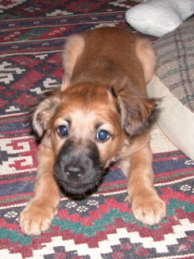


Continuous image
Digital image

Slide 49
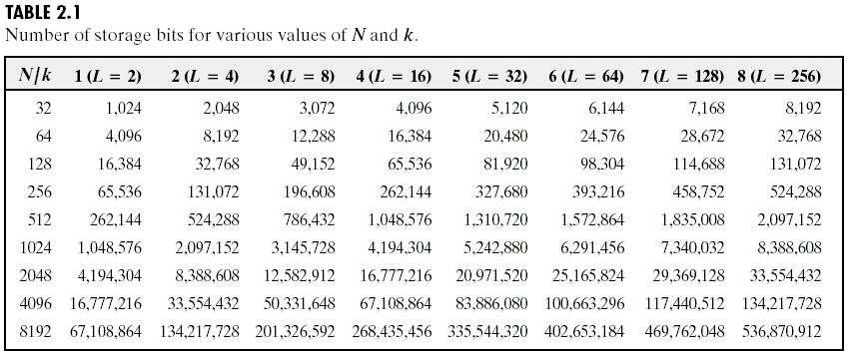
Number of storage bits

Slide 50
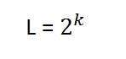
Relation of Quantization with gray level resolution
L—no. Of gray levels
K-no of bits per pixel
Reducing the gray level
For example:
Lets say you have an image of 8bpp, that has 256 different levels. It is a grayscale image and the image looks something like this.

Slide 51
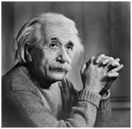
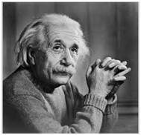
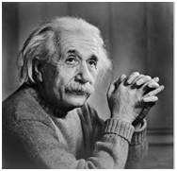

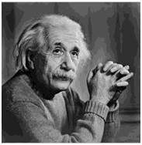
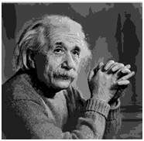
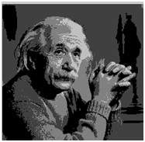
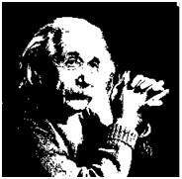
256 Gray Levels
128 Gray Levels
64 Gray Levels
32 Gray Levels
16 Gray Levels
8 Gray Levels
4 Gray Levels
2 Gray Levels

Slide 52
Contouring:
There is an interesting observation here , that as we reduce the number of gray levels , there is a special type of effect start appearing in the image , which can be seen clear in 16 gray level picture. This effect is known as Contouring.

Slide 53
Spatial Resolution and Intensity resolution
---Is a measure of smallest discernible detail in an image.
--line pairs per unit distance
--dots/pixels per unit distance
---Graphic designers will talk about dots per inch (DPI)
(printing and publishing industry)
Newspapers –75 dpi
Magazines---133dpi
Glossy brochures –175 dpi
Book pages--2400dpi
Vision specialists will often talk about pixel size.

Slide 54
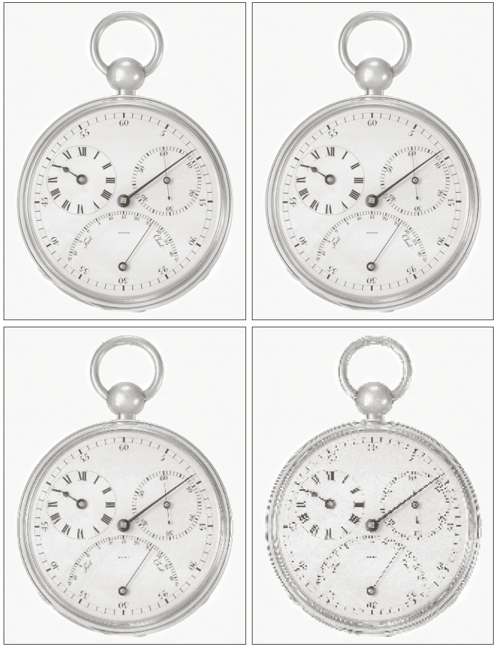
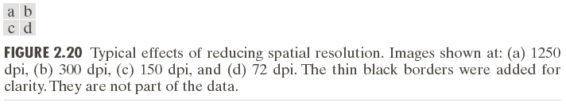
Reducing spatial resolution

Slide 55
Interpolations Zooming and shrinking (image resizing)

Slide 56
Some Basic Relationships Between Pixels
Neighborhood
Adjacency
Connectivity
Paths
Regions and boundaries

Slide 57
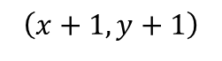
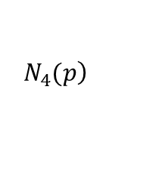
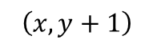
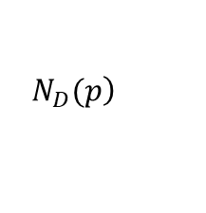
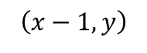
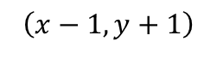
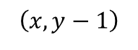
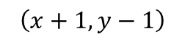
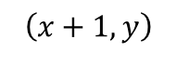
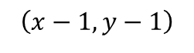
Neighborhood
4-neighbors of p
$$\left.N_{4}(p\right)$$
$$\left(x+1,y\right)$$
$$\left(x−1,y\right)$$
$$\left(x,y+1\right)$$
$$\left(x,y−1\right)$$
 | (x, y-1)
(x-1, y) | P (x,y) | (x+1, y)
 | (x, y+1)
4- diagonal neighbors of p
$$\left.N_{D}(p\right)$$
$$\left(x+1,y+1\right)$$
$$\left(x+1,y−1\right)$$
$$\left(x−1,y−1\right)$$
$$\left(x−1,y+1\right)$$
(x-1, y+1) |  | (x+1, y-1)
 | P (x,y)
(x-1, y-1) |  | (x+1, y+1)

Slide 58
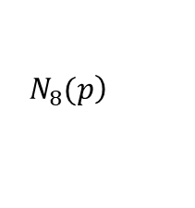


8-neighbors of p
$$\left.N_{8}(p\right)$$
$$\left.N_{4}(p\right)$$
and
$$\left.N_{D}(p\right)$$
(x-1, y+1) | (x, y-1) | (x+1, y-1)
(x-1, y) | P (x,y) | (x+1, y)
(x-1, y-1) | (x, y+1) | (x+1, y+1)

Slide 59
Adjacency and Connectivity
Let V: a set of intensity values
In a binary image, V = {1}, if we are referring to adjacency of pixels with value 1.
In a gray-scale image, V = {180, 181, 182, …, 200}
If the possible intensity values 0 – 255, V set can be any subset of these 256 values.

Slide 60
Types of Adjacency
4-adjacency: Two pixels p and q with values from V are 4-adjacent if q is in the set N₄(p).
8-adjacency: Two pixels p and q with values from V are 8-adjacent if q is in the set N₈(p).
m-adjacency =(mixed)
Two pixels p and q with values from V are m-adjacent if :
q is in N₄(p) or
q is in N_{D}(p) and the set N₄(p) ∩ N₄(q) has no pixel whose values are from V (no intersection)

Slide 61

Mixed adjacency is a modification of 8-adjacency.
It is introduced to eliminate the ambiguities that often arise when 8-adjacency is used.
For example:

Slide 62

Connectivity
Let S represent a subset of pixels in an image, Two pixels p and q
are said to be connected in S if there exists a path between them.
Two image subsets S1 and S2 are adjacent if some pixel in
S1 is adjacent to some pixel in S2

Slide 63

We must specify the connectivity being used to define adjacency

Slide 64
Connected Components
If p and q are pixels of an image subset S then p is connected to q
in S if there is a path from p to q consisting entirely of pixels in S.
• For every pixel p in S, the set of pixels in S that are connected to p
is called a connected component of S.
• If S has only one connected component then S is called Connected Set.

Slide 65
Path
• A digital path (or curve) from pixel p with coordinate (x,y) to pixel q with coordinate (s,t) is a sequence of distinct pixels with coordinates (x0, y0), (x1, y1), ..., (xn, yn), where
(x0, y0)= (x,y), (xn, yn)= (s,t)
• (xi, yi) and (xi-1, yi-1) adjacent for 1≤i≤n ,
• n- The length of the path.
• If (x0, y0)= (xn, yn):the path is closed path.
• We can define 4- ,8- , or m-paths depending on the type of adjacency specified.

Slide 66
Return to the previous example:
In figure (b) the paths between the top right and bottom right pixels are 8-paths. And the path between the same 2 pixels in figure (c) is m-path

Slide 67

Region
R--be a subset of pixels in an image, we call R a region of the image, If R is a connected set. Two regions are said to be adjacent if thier union forms a connected set.
• Region that are not adjacent are said to be disjoint.
• Example: the two regions (of 1s) in figure, are adjacent only if 8-adjacany is used.
4-path between the two regions does not exist, (so their union in not a connected set).

Slide 68

Boundary (border)
image contains K disjoint regions, Rk, k=1, 2, ...., k, none of
which touches the image border.

Slide 69

Let: Ru - denote the union of all the K regions
Complement of it ( the set of points that are not in S).
Ru - called foreground of the image;
Boundary (border or contour) of a region R is the set of points that are adjacent to points in the complement of R .
Another way the border of a region is the set of pixels in the region that have at least one background neighbor.
called background of the image.
If R is entire image, its boundary is the first and last rows and columns of pixels.

Slide 70

Distance measures

Slide 71



Slide 72



Slide 73

Dm Distance Measures
Example:
Consider the following arrangement of pixels and assume that p, p₂, and p₄ have value 1 and that p₁ and p₃ can have can have a value of 0 or 1
Suppose that we consider
the adjacency of pixels
values 1 (i.e. V = {1})

Slide 74


Cont. Example:
Now, to compute the D_{m} between points p and p₄
Here we have 4 cases:
Case1: If p₁ =0 and p₃ = 0
The length of the shortest m-path
(the D_{m} distance) is 2 (p, p₂, p₄)
Cont. Example:
Case2: If p₁ =1 and p₃ = 0
now, p₂ and p will no longer be adjacent (see m-adjacency definition)
then, the length of the shortest
path will be 3 (p, p₁, p₂, p₄)

Slide 75


Cont. Example:
Case3: If p₁ =0 and p₃ = 1
The same applies here, and the shortest –m-path will be 3 (p, p₂, p₃, p₄)
Cont. Example:
Case4: If p₁ =1 and p₃ = 1
The length of the shortest m-path will be 4 (p, p₁ , p₂, p₃, p₄)

Slide 76


Slide 77

VESIT
AI and DS

Slide 78

VESIT
AI and DS

Slide 79

VESIT
AI and DS

Slide 80

VESIT
AI and DS

Slide 81

VESIT
AI and DS

Slide 82

VESIT
AI and DS

Slide 83

VESIT
AI and DS

Slide 84

VESIT
AI and DS

Slide 85

VESIT
AI and DS

Slide 86

VESIT
AI and DS

Slide 87

VESIT
AI and DS

Slide 88

VESIT
AI and DS

Slide 89

VESIT
AI and DS

Slide 90

VESIT
AI and DS

Slide 91

VESIT
AI and DS

Slide 92

VESIT
AI and DS

Slide 93

VESIT
AI and DS

Slide 94


Slide 95


Slide 96


Slide 97


Slide 98


Slide 99


Slide 100


Slide 101


Slide 102


Slide 103


Slide 104


Slide 105


Slide 106


Slide 107


Slide 108


Slide 109


